Slide 1
Colorado SOAR/IPS Integration
Colorado Disability Benefits
Support Program
Solving the Puzzle!

Slide 2
Process
March, 2016 – IPS Trainer hired by Colorado DBS, the Lead SOAR Agency in the State of Colorado.
IPS Trainer – Train/Education Employment Specialists in 4 identified area of the State; Assess sites for readiness/IPS implementation; Provide TA; Help with Organizational Change; Provide statewide leadership for IPS along with OBH Partners
IPS Trainer – SOAR Certification/CWIC Certification

Slide 3
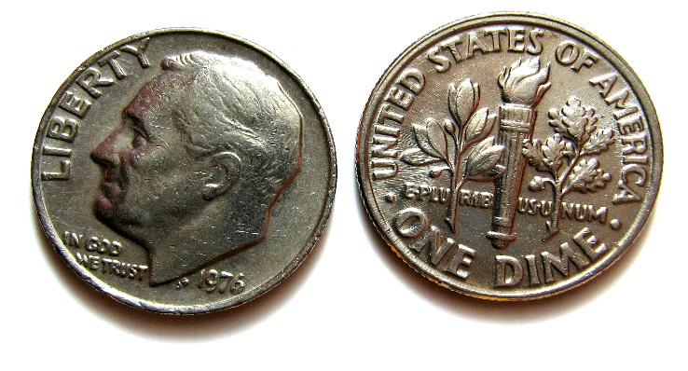
Colorado Message: Tools for Recovery!
Colorado DBS is working diligently to emphasize the paradigm shift of:
Applying for SSA benefits,
Benefits planning (a critical component of IPS Supported Employment)
Employment
Employment supporting recovery
All at the same time

Slide 4
Form Changes
CABHI Screening Tool updated to include IPS Supported Employment
IPS Career Profile updated to include SOAR Practitioner
CABHI Referral Form includes both SOAR and IPS

Slide 5
Challenges
Training
IPS-Supported Employment, SOAR & CWIC
Buy-In – CABHI sites
Education & Training
Funding
No-Cost Extension – IPS Trainer & CABHI Sites
Tracking
Multiple Tracking Requirements: IPS Quarterly Outcomes; OAT; SOAR/IPS

Slide 6
Moving Forward
Ongoing Evaluation/Review
Forms/Training
Fidelity Reviews
Update Colorado SOAR Application Components’ Checklist*/IPS
On-going Consultation & Technical Assistance
Inclusion of CLAS Standards
IPS Expansion
Colorado Works/IPS *Adapted from the CBHC and CCH checklists

Slide 7
Recommendations
Streamline Tracking Systems
Integrate IPS to OAT Data Base
IPS Trainer & SOAR Practitioner Team
Integrate Employment Specialists to IPS/SOAR Team (Colorado model)
CWIC Training for IPS/SOAR Team

