Slide 2
Innovative Strategies to Fund SOAR Programs
SAMHSA’s Homeless and Housing Resource Network (HHRN) Webinar
Wednesday, February 4, 2015
2:00-3:30 p.m. ET

Slide 3
Presenters
Kristin Lupfer, M.S.W., Project Director, SOAR Technical Assistance (TA) Center
Emily Carmody, LCSW, Project Specialist, North Carolina Coalition to End Homelessness
Peter J. Pike, Executive Director, Colorado Disability Benefits Support Program (DBS)

Slide 4
This training is supported by the Substance Abuse and Mental Health Services Administration (SAMHSA) and the U.S. Department of Health and Human Services (DHHS).
The contents of this presentation do not necessarily reflect the views or policies of SAMHSA or DHHS. The training should not be considered a substitute for individualized client care and treatment decisions.

Slide 5
SOAR Funding Strategies SSI/SSDI Outreach, Access, & Recovery SAMHSA SOAR Technical Assistance Center
Sponsored By: Substance Abuse And Mental Health Services Administration U.S. Department Of Health And Human Services
Kristin Lupfer Project Director SAMHSA SOAR TA Center (518) 439-7415 x5262
klupfer@prainc.com

Slide 6
Funding SOAR Programs
There is no dedicated source of federal funding for SOAR programs
Yet, all 50 states participate!
Reallocating existing resources
Securing funding through federal and state grants and foundation funding
Establishing collaborations with hospitals and criminal justice settings

Slide 7
Create a Funding Framework
Know your “ask”
Explore potential resources
Create a funding action plan
Who, what, when, how
Record and revisit responses
Market your program
Develop an elevator pitch
Show value for money

Slide 8
Federal Funding: SAMHSA
Projects for Assistance in Transition from Homelessness (PATH)
Similar components: outreach, engagement, assessment, documentation, recovery
PATH funds support dedicated SOAR benefits specialists, SOAR training, and statewide leadership and coordination in many states
Encourage your State PATH Contact to include SOAR activity in PATH contracts
Notes:
PATH provides outreach and supportive services for adults with serious mental illness or substance use disorders who are experiencing or at risk of homelessness.
SOAR is in PATH contracts in: Michigan, California, Montana, Tennessee, Georgia, West Virginia (pending), (others??)
The PATH Director is the STL in about half of all states.
Beneficial to have the State PATH contact on the state steering committee.

Slide 9
Federal Funding: SAMHSA
Community Mental Health Services Block Grant (MHBG)
Cooperative Agreements to Benefit Homeless Individuals (CABHI)
Olmstead
Adult Treatment Drug Courts
Notes:
MHBG - funds priority treatment and support services not covered by Medicaid, Medicare or private insurance for low income individuals that demonstrate success in improving outcomes and/or supporting recovery
CABHI – Purpose is to build/strengthen infrastructure and treatment systems, so that individuals who are experiencing homelessness have better access to housing, treatment, and mainstream benefits. Funds dedicated SOAR benefits specialists in Colorado, Connecticut, Nebraska, and New Mexico.
Olmstead – Funds are administered by SAMHSA which provides funds to states (usually the Department of Mental Health). In North Carolina, the SOAR Coordinator (state coordination) is funded by Olmstead. In Maine, SOAR coordination is being funded thru Olmstead as well as PATH finders and peer navigators.
Adult Treatment Drug Courts - Nevada utilizes this grant to fund a SOAR benefits specialist in the court system.

Slide 10
Federal Funding: HUD
Community Development Block Grant (CDBG)
A flexible program that provides communities with resources to address unique community development needs
Distributes annual grants on a formula basis to local governments and states
SOAR programs have used these funds to support dedicated benefits specialists

Slide 11
Federal Funding: VA/SSVF
Supportive Services for Veteran Families (SSVF)
July 2014 survey:
SSVF grantees are involved in SOAR in 44 of 52 states and territories
146 of the 319 individual SSVF grantees are actively using SOAR
Services include increasing access to mainstream benefits
Notice of funding includes the expectation that grantees will use the SOAR model through community linkages or staff training
Many grantees have amended their budgets to support a dedicated SOAR benefits specialist

Slide 12
Federal Funding: AmeriCorps
AmeriCorps State
Provide direct outreach, engagement, and assistance with SSI/SSDI applications
A cash or in-kind match is required for program costs
Apply for a grant through your governor-appointed State Service Commission
www.nationalservice.gov

Slide 13
Federal Funding: AmeriCorps VISTA
AmeriCorps VISTA
Can identify potential SOAR collaborations, organize local SOAR planning meetings, fundraise for dedicated SOAR staff, collect data, and coordinate future trainings
Apply through your state Corporation for National and Community Service office
No required funding match from sponsors, but there is a cost-share option
SOAR TA Center issue brief on AmeriCorps

Slide 14
Medicaid and State Health Programs
Medicaid is a state-operated program, federal and state share the cost
State creates a plan for what services are billable
Case management services necessary for SOAR applications may be billable or allowable services
Tennessee: Behavioral Health Safety Net providers can bill for SOAR application assistance
Georgia: Six regional positions statewide for Medicaid Eligibility Specialists

Slide 15
State or County General Assistance (GA)
GA funds offer time-limited cash benefits to adults without dependents who have limited or no income
These benefits are not available in every state
Through an Interim Assistance Reimbursement (IAR) agreement, the Social Security Administration (SSA) can reimburse state or local public assistance funds when individuals begin receiving SSI
Notes:
2014 Reimbursement data?

Slide 16
State or County Temporary Assistance for Needy Families (TANF)
TANF is a block grant from the U.S. Department of Health and Human Services
Provides time-limited assistance to families with dependent children to help them become self-sufficient through employment
For parents who cannot meet the TANF work requirements, SSI/SSDI may meet their needs and save state funds

Slide 17
State/Local Plans to End Homelessness
Most plans to end homelessness incorporate increasing access to mainstream benefits
Can fund SOAR leadership, coordination, and dedicated benefits specialists
Find your local plan and promote how SOAR helps meet this goal
Nashville, Tennessee: 10-year plan funds three positions in community mental health center
Since May 2006, SOAR providers in Nashville achieved a 98% approval rate for 692 applications; in 2014, they averaged 37 days to decision
Notes:
**Nashville numbers are not only for Park Center. They represent multiple community providers

Slide 18
Foundation & Other Private Funding
United Way: Funds coordination of SOAR in Trenton, New Jersey, and staffing of SOAR programs in other localities
Pharmaceutical and insurance companies: GlaxoSmithKline, Blue Cross Blue Shield, and Kaiser Permanente fund SOAR programs in North Carolina and Oregon
www.foundationcenter.org

Slide 19
Hospital Collaborations
Hospitals can recoup payments for previously uncompensated care when individuals approved for SSI obtain Medicaid
SOAR providers may receive funding from hospitals for dedicated SOAR benefits specialists to help individuals access SSI/SSDI and health insurance
In 2014, states reported an average $10,465 reimbursed from Medicaid per SOAR approval
SOAR TA Center issue brief on hospital collaborations
Notes:
States reporting Medicaid reimbursements
Alaska, Arkansas, Florida, Georgia, Kansas, Missouri, Nebraska, North Carolina, Tennessee, Washington

Slide 20
Criminal Justice System Collaborations
Diversion courts, in-reach initiatives, re-entry planning, and SOAR-trained corrections staff
Reduces recidivism, prevents incarceration, saves money
In 2009, the Miami-Dade Jail Diversion Program estimated cost-savings to the state of $7 million
Results leveraged ongoing funding for SOAR
In 2014: 260 applications, 91% approval rate in 28 days
Notes:
Reduces recidivism, prevents incarceration, saves money for states and communities
I removed the last bullet (SOAR TA Center issue brief on criminal justice collaborations) to mention during facilitation
Updated 12/19/14 - DW

Slide 21
Other Partnerships
Programs serving targeted groups
Veterans
Youth leaving foster care
Local colleges and universities
Social work field placements or internships
Students get experience working with clients and help grow an agency’s SOAR program
Peer support organizations
SOAR TA Center issue brief on utilizing peer support workers with SOAR

Slide 22
Growing & Sustaining SOAR
Be creative
Use your outcomes
Share success stories with the press
Give presentations to potential funders
Create linkage with influential leaders—both private and public
Keep persisting!

Slide 23
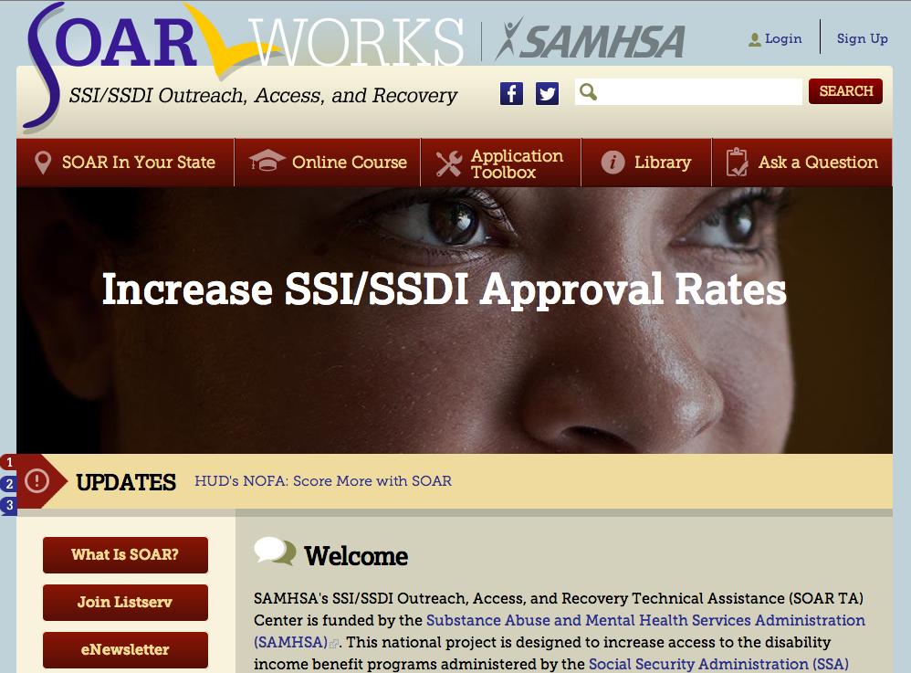
https://soarworks.prainc.com

Slide 24
For More Information on SOAR
Visit our website: http://soarworks.prainc.com
SAMHSA SOAR TA Center 345 Delaware Avenue Delmar, New York 12054 (518) 439 – 7415
soar@prainc.com www.facebook.com/soarworks
@SOARWorks

Slide 25
Colorado Disability Benefits Support Program
Strategies for Funding SOAR Programs
Peter J. Pike, Executive Director
(720) 234-5907
Peter.pike@coloradodbs.org

Slide 26
Colorado DBS
Opened doors August 2012
Nonprofit organization—March 2013
SOAR State Lead Agency

Slide 27
Colorado DBS Mission
Assist individuals with disabilities, including those with chronic conditions/illnesses, to acquire income, health insurance, and other basic needs to stabilize their lives, health, and living situations!

Slide 28
Funding $trategies
Foundations
The Colorado Health Foundation
Caring for Colorado Foundation
The Denver Foundation
The Buck Foundation

Slide 29
Funding $trategies
Contracts
Nonprofits
Colorado Behavioral Healthcare Council—SOAR Training
County
Jefferson County Human Services—Temporary Assistance for Needy Families (TANF)
State —Colorado Department of Human Services
Office of Behavioral Health—Cooperative Agreement to Benefit Homeless Individuals (CABHI)
Office of Economic Security—AND (Temporary Cash Assistance Program)

Slide 30
Funding $trategies
Fees for Service
SSA Disability Benefits 101—Introductory workshops
SOAR training events

Slide 31
Funding $trategies
Legislative
HB 11-1216 Laura Hershey Memorial Disability Benefits Act
Allows the state to auction off the right to use certain license plate letter and number combinations
Disability Benefits Support Contract Committee
SB 14-012
Authorizes a pilot program for AND-eligible recipients in three counties
Authorizes a rule change allowing 60 days to submit SSI application for AND

Slide 32
North Carolina SOAR: Funding for SOAR positions
Emily Carmody North Carolina Coalition to End Homelessness
(919) 755-4393 emily@ncceh.org
North Carolina Coalition to End Homelessness
securing resources encouraging public dialogue advocating for public policy change
North Carolina Coalition to End Homelessness
919.755.4393 www.ncceh.org

Slide 33
Overview of SOAR in North Carolina

Slide 34
History of SOAR in North Carolina
North Carolina became a SOAR state in 2007
Initial strategy to train large numbers of case managers and direct service providers
2008—North Carolina Department of Health and Human Services contracted with NCCEH for State Lead Position
2009—Changed strategy to developing and training dedicated SOAR caseworker positions within programs
North Carolina Coalition to End Homelessness

Slide 35
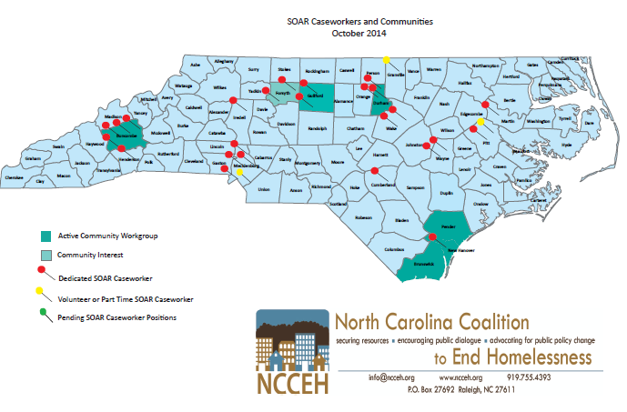
SOAR Caseworkers and Communities

Slide 36
North Carolina Outcomes
Outcomes as of December 31, 2014
Total outcomes reported | 1,608
Total approved (8 deaths prior to decision) | 1,287
Total denied | 313
Approval rate | 80%
Average time between completion of application and determination | 100 days (Median: 88 days)
Percentage that required CE | 38%
Average length of time homeless prior to application | 2 years, 8 months
Income brought into state since June 2, 2010 (includes first year of annual income and back pay awarded to applicants) | $17,068,185.21

Slide 37
SOAR State Lead Position

Slide 38
SOAR State Lead
2008—NCCEH contracted with North Carolina’s Department of Health and Human Services for SOAR State Lead Position
Emphasized ongoing TA beyond the initial training
Deliverable contract that included:
Training—scheduling, staffing, application process, etc.
Ongoing TA and Quality Assurance
Gathering SOAR Outcomes and Reporting
Liaison with SSA and North Carolina Disability Determination Services (DDS)
Develop SOAR positions and SOAR community programs

Slide 39
SOAR State Lead
Benefits of full-time lead:
Creates vision and infrastructure for SOAR program
Provides a face of the SOAR program for funders/agencies
Develops a relationship with SSA and DDS
Grows and coordinates SOAR program through positions and community work groups
Supports SOAR caseworkers
Provides TA for quality applications
Develops new tools for caseworkers
Shares ideas from across the state and country
Validates and reports SOAR outcomes for state, communities, caseworkers, and funders
Enhances other homeless advocacy efforts in the state

Slide 40
SOAR State Lead
Funding streams:
2008-2012—North Carolina’s Interagency Council on Coordinating Homeless Programs (ICCHP) —State funding
NC DHHS Office of Housing and Homelessness
Annual contract approved by ICCHP
ICCHP funding was not renewed in 2012 state budget
2013-2014—Olmstead funds—federal funding
Housed with the Division of State Operated Healthcare Facilities
Two-year contract for one-time funding
2015—Working to identify state funding

Slide 41
Dedicated SOAR Caseworkers

Slide 42
Dedicated SOAR Caseworker Positions
2009—Began developing positions across the state
27 full-time positions dedicated to completing SOAR cases in North Carolina
Housed in a variety of agencies:
Homeless service providers (shelters, permanent supportive housing (PSH), outreach teams, etc.)
Legal aid and disability advocate organizations
Mental health and community health provider agencies
Managed Care Organizations (mental health)
County government
North Carolina Coalition to End Homelessness

Slide 43
Dedicated SOAR Caseworker Positions
Benefits:
Increases number of SOAR applications completed
Develops expertise quickly
Draws community attention to SOAR and builds SOAR programs in communities
Creates a support network for caseworkers across the state
North Carolina Coalition to End Homelessness

Slide 44
Dedicated SOAR Caseworker Positions
Funding streams and benefits
PATH (Projects for Assistance in Transition from Homelessness) funding
Fits with mission of serving individuals with untreated mental health and substance abuse issues who are homeless
Assists PATH teams with goals of treatment and housing
County/city funding
Income into the local economy (tracking dollar amount of benefits)
Reduction in costs with stable housing and services (ER, jail, etc.)
North Carolina Coalition to End Homelessness

Slide 45
Dedicated SOAR Caseworker Positions
Funding streams and selling points
Managed Care Organizations in capitated system
Targeting high need/high utilizers who are uninsured
Able to switch individuals to more appropriate funding streams and connect to appropriate services
Housing stabilization decreases use of emergency services and inpatient stays
Potential for Medicaid reimbursement for services provided
Increases Medicaid-covered population
North Carolina Coalition to End Homelessness

Slide 46
Dedicated SOAR Caseworker Positions
Funding streams and selling points
Mental health and community health providers
Able to switch individuals to more appropriate funding streams and connect to more appropriate services
Housing stabilization increases therapeutic benefits
Potential for Medicaid reimbursement for services provided
LATCH in Durham—Foundation grant to fund navigator/SOAR caseworker positions
North Carolina Coalition to End Homelessness

Slide 47
Dedicated SOAR Caseworker Positions
Funding streams and selling points
Hospitals
Housing stabilization decreases use of emergency services and costs
Stabilization in housing and services reduces lengths of stay and re-admittance to hospital—costs and potential penalties
Medicaid reimbursement
Foundations
Concrete work with outcomes to report
Good for first year of program while tracking outcomes for other funding sources (hospitals, local government, etc.)

Slide 48
Dedicated SOAR Caseworker Positions
Things to consider when developing positions:
Targeting applicants
Focus on key population
Intra-agency referrals only
Community referrals
Tracking outcomes
Special outcomes to track
Arrangements to track outcomes (i.e. reimbursements, expenses pre- and post-)
Realistic expectations
North Carolina Coalition to End Homelessness

Slide 49
Dedicated SOAR Caseworker Positions
Things to consider when developing positions:
Existing services who apply for Medicaid and/or SSA benefits
Often found with hospitals
Differences: population served, approval rate
Ways to support agency:
Job description
Ongoing TA support
Supervisor/staff trainings
Outcome reporting
North Carolina Coalition to End Homelessness

Slide 50
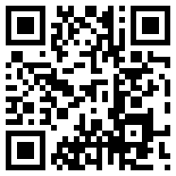
Contact NCCEH
NCCEH webpage: www.ncceh.org
Learn more! Join our mailing list! Become a member!

Slide 51
Presenter Contact Information
Peter J. Pike
Colorado Disability Benefits Support Program
3532 Franklin Street, Suite S
Denver, CO 80205
(720) 234-5907
Peter.pike@coloradodbs.org
Kristin Lupfer, LMSW Project Director SAMHSA SOAR TA Center Policy Research Associates, Inc. Delmar, NY 12054 (518) 439-7415 x5262
klupfer@prainc.com http://soarworks.prainc.com
Emily Carmody, LCSW Project Specialist North Carolina Coalition to End Homelessness
(919) 755-4393 emily@ncceh.org

